Slide 1
STARS! Training for Managers: Using the Strategic Talent Assessment and Reporting System
Kristan Williams
Soave HR Dept

Slide 2
Agenda
STARS! Concepts
Introduction to the STARS! Software
Setting and Managing Goals
Understanding Roles in Goal Management
Goal Plan Basics
Creating SMART Goals
Goal Alignment: Cascading Goals
Creating Development Goals
Performance Appraisal Process
Performance Appraisal Steps
Tools to Assist in Writing Evaluations
Support and Resources
Q&A (throughout)

Slide 3
STARS! Process
Set Expectations
Set Up A Performance Review Plan
Mid-Year Assessment (highly recommended)
Year End Assessment
Plan for the Future
Employee and Manager define annual goals.
Employee and Manager define specific focus areas.
Employee and Manager comment on performance.
Manager assesses employee performance.
Manager reviews employee development & performance for future planning.

Slide 4
Setting and Managing Goals

Slide 5
Goal Types
Business Goals
The Employee and their Manager together define "WHAT" the employee is going to accomplish.
Development Goals
Goals designed to improve skills to assist in career development.
Located in the Development Plan tab.
During the review period, you will have the opportunity to review and, if necessary, modify these goals with your manager.
Located in the Goal Plan tab.

Slide 6
Understanding Roles in Goal Management
Employee
Create SMART Goals aligned to their current job and business unit priorities.
Collaborate with manager to update and add tasks on cascaded goals.
Manager
Work collaboratively to update, and provide feedback on employee’s goal plan.
Ensure employee’s goals align to achieve role, team, and business unit goals.
Focus current job performance to achieve goals and pursue individual career development goals.
Actively monitor Goals ensuring effective communication of progress up and down the organization.

Slide 7
Writing SMART Goals
A SMART Goal is:
Specific | Goals should be straightforward and emphasize the business result that you would like to achieve.
Measurable | Establish concrete criteria for measuring progress toward the attainment of each goal that you set.
Attainable | Goals must be within your capacity to reach. You cannot commit to accomplishing goals that are too far out of your reach, or unreasonable.
Relevant | Make sure each goal is consistent with other goals you have established and fits with your immediate and long-range plans.
Time Bound | Setting an end point on your goal gives you a clear target to work towards.
Notes:
A goal describes achievements the employee hopes to accomplish during the upcoming year.
The SMART methodology helps to ensure goals are written in a way that promotes success.

Slide 8
Exercise: Writing SMART Goals
Is this Goal SMART?
Specific
Measurable
Attainable
Relevant
Time Bound
“Try to improve customer retention as quickly as possible.”
Notes:
Insert Poll here to vote yes or no

Slide 9
Exercise: Writing SMART Goals
Modified using the SMART methodology:
Specific
Measurable
Attainable
Relevant
Time Bound
“Implement a customer retention program to increase retention rates by 10% by year end.”

Slide 10
Alignment: Cascading Goals
Business Unit Vision & Strategy
Aligning Goals ties individual goals to larger goals:
Cascading a goal copies a goal to another person, such as from a manager to a direct report within the hierarchy. You may wish to cascade goals to your direct reports.
Once a goal is aligned, managers have line of sight into overall progress toward completion.
Cascade
Cascade
Individual, Team & Group Goals

Slide 11
Alignment: Example
BU Leader: Increase profitability
Sales Mgt: Increase Bookings
Sales Rep: Close X $ in business each quarter
Event Coordinator: Conduct X # of trade shows per quarter
Marketing Mgt: Increase Leads
Business Unit Goal
Departmental Goal
Individual Goal
Broad corporate goals can be broken down into supporting goals necessary to achieve the desired financial outcome for the business unit.

Slide 12
Performance Appraisal Process

Slide 13
Performance Appraisal Steps
Employee
Self Review*
Manager Review
Discussion and Signature
HR Review
Email notification to employee
Email notification to manager
Email notification to HR
Email notification to manager
Manager signs form, holds discussion with employee then sends the form to the employee for signature
Employee enters self rating and comments on performance then sends the form back to the manager for review
Manager enters employee rating and comments on performance then sends the form to HR for review prior to holding discussion with employee
HR reviews appraisal and may enter comments then sends the form back to the manager for additional review or signature
Email notification to employee
Employee signs
Email notification to HR
*This step may be optional for some business units
HR signs and completes the process

Slide 14
Rating Scale
Descriptor | Definition
Excellent | Consistently exceeds the required level for this job role.
Satisfactory with Commendation | Exceeds the required level for this job role.
Meets Expectations | Satisfies the requirements for this job role fully.
Satisfactory with Reservation | Limited adequacy in the required level for the job role.
Unsatisfactory | Does not adequately satisfy the requirements of the job role.

Slide 15
Demo: Performance Evaluation Form
Notes:
Log in as Edward and demo:
Opening the form
Form sections
Form toolbar
Less detail and More detail view options
Route map

Slide 16
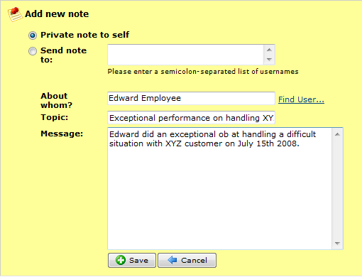
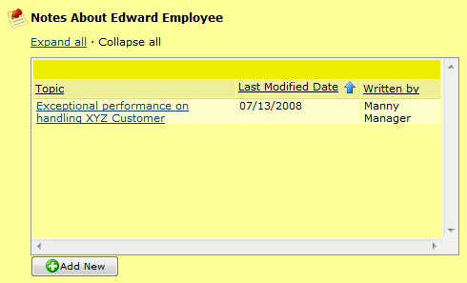
Tools to Assist in Writing Reviews: Notes
Access from Employee Files or the Performance Evaluation form
Keep notes private or send to other team members
Use to track progress on events and behaviors throughout the year that may impact performance evaluation

Slide 17
Performance Review Section Summary
Use Notes throughout the year to track events that may impact performance evaluation.
Save the form during editing to see updates in the summary section.
Use the Writing Assistant, Coaching Advisor, Spell Check and Legal Scan tools to assist in crafting feedback.
View En Route and Completed forms in their associated folders in the form inbox.

Slide 18
Conducting the Review Discussion
When and where to meet
Prepare by sending the review form to HR for review prior to the meeting.
Discuss current job development and career development.
Be clear and confident about your performance feedback.
What to discuss during the meeting
Review and give feedback on the individual’s performance.
Goals & results.
Competencies.
Development needs.
Communicate your overall rating of the individual’s performance.
Meeting Best Practices
Schedule a meeting in a place where you will not be interrupted. Turn off phones, pagers, computers and give your full attention to the conversation.
Be prepared.
Don’t rush and give your direct report your full attention.
Make the meeting a collaborative conversation; both of you talk and listen.
Make sure that you allow time to focus on the future, not just the past.

Slide 19
Support and Resources
eLearning Tutorial
Housed on the soave.com website on the STARS! log-in page.
For questions regarding your business unit's performance management process:
Please contact your Human Resources Manager or Human Resources Representative.
For technical questions regarding the STARS! website:
Please contact Kristan Williams at 313-567-7000 ext. 472 or STARS@soave.com.

Slide 20
Thank You!

